Slide 1
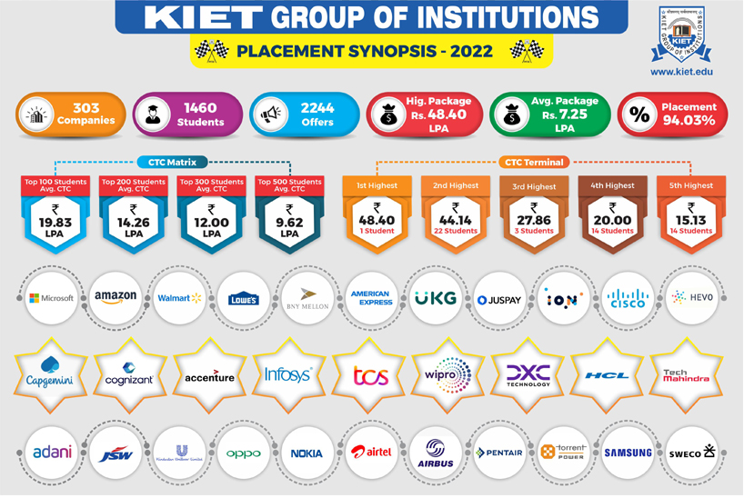
CAMPUS PLACEMENT WEBSITE

Slide 2
About TEAM MEMBERS
Team Leader : SOUMYA JAIN
Team Members :
SHAGUN JINDAL
MUNISH RAI
BUNTY CHAUHAN
Project Supervisor:
DIVYA SINGHAL

Slide 3
INTRODUCTION
To eliminate the need of putting up notice or Emailing every student about the company coming in campus looking for potential employees/ Interns. The Students can keep updated themselves through this software.
To enable companies to view all students detail and system can shortlist students according to their criteria instead of doing manually or waiting till students or graduates physically go to organisations apply.
To enable students going for internship register online instead of Platform looking for internship or going to placement department for registration.

Slide 4
Tools and Environment
Hardware Requirements
• Processor : Intel Pentium22020M@2.40GHZ
• Ram :4.00GB
• Hdd : 10GB Freespace or above
System Type :64/128-Bit Operating System

Slide 5
Software Requirements:
• Backend : PHP
• Database : MY SQL
• Front End :HTML, CSS, BOOTSTRAP
• Operating System : WINDOWS10/WINDOWS11

Slide 6
MODULES
The different types of modules present in this project are
1. Admin
2. Company
3. User(Candidates/ Students)
Module Description

Slide 7
1.Admin
Dashboard: In this section, admin can see all detail in brief like Total Company Registered, Total User (Candidates) Registered and Total Vacancy Listed.
Total Registered Company: In this section, admin can view detail of registered company.
Total Registered Users: In this section, admin can view detail of users.
Pages: In this section, the admin can manage about us and contact us pages.
Reports: In this section admin can view how many company has been registered in particular period and also view how many vacancy counts listed by particular company in particular periods.

Slide 8
2. Student Model
A student is registered by the site. A student can apply a job for the company and eligible students give an online exam which is held by the company . The student module deals with the information of the student.
A student who has added by the administrator to the system successfully can only able to access the system with their valid user name and password provided by the administrator. The first student should log in to the system by entering PRN as their user name and password. Students can able to update his information such as name, branch, year, aggregate marks, contact number, email, etc. by clicking on Update Details option and also upload their Resume.
The change password field is used by the student if he needs to change his password as same in the admin module. After completing a task successfully by click on the Logout, the student can successfully log out from the system.

Slide 9
3.COMPANY MODULE
The Company enter his user_id and password and can login to his home page where he is having options to update the details and have a facility to post their vacancy .
Users have the privilege to see the students who are applied for that vacancy and view/download the details of accepted students.

Slide 10
Reports/Output
It generates the report on College, Company, Placement.
Provide filter reports on Job, Student, Vacancy .
You can easily export PDF for the college, Placement. Student.
Applications also provides excel export for Company, Job, Vacancy
You can also export the report into csv format for college, company, Vacancy

Slide 11
CONCLUSION
Presently we designed our Training & Placement Cell to be very User Friendly. Many features are enhanced to the present Training & Placement Cell. With this Training & Placement Cell, most of the TPO's time is saved. The features of the system can be further enhanced in many ways.
The documentation that has enclosed can enable even a person with minimum knowledge to understand it well. It can successfully login the authorized person to a system and register them.
In our system admin can check the Student list those eligible according to criteria given by the Company and notify them instantly and update the information anytime successfully.
Our system is Secure and User-friendly for all three modules.

Slide 12
Thank you

